Slide 1
MATHEMATICAL MODELING OF RECOMBINANT DNA EXPRESSION
Presenter: M.A.A. Aqeel
Co-author: Dr. S.P. Rajapaksha
University of Sri Jayewardenepura

Slide 2
INTRODUCTION

Slide 3
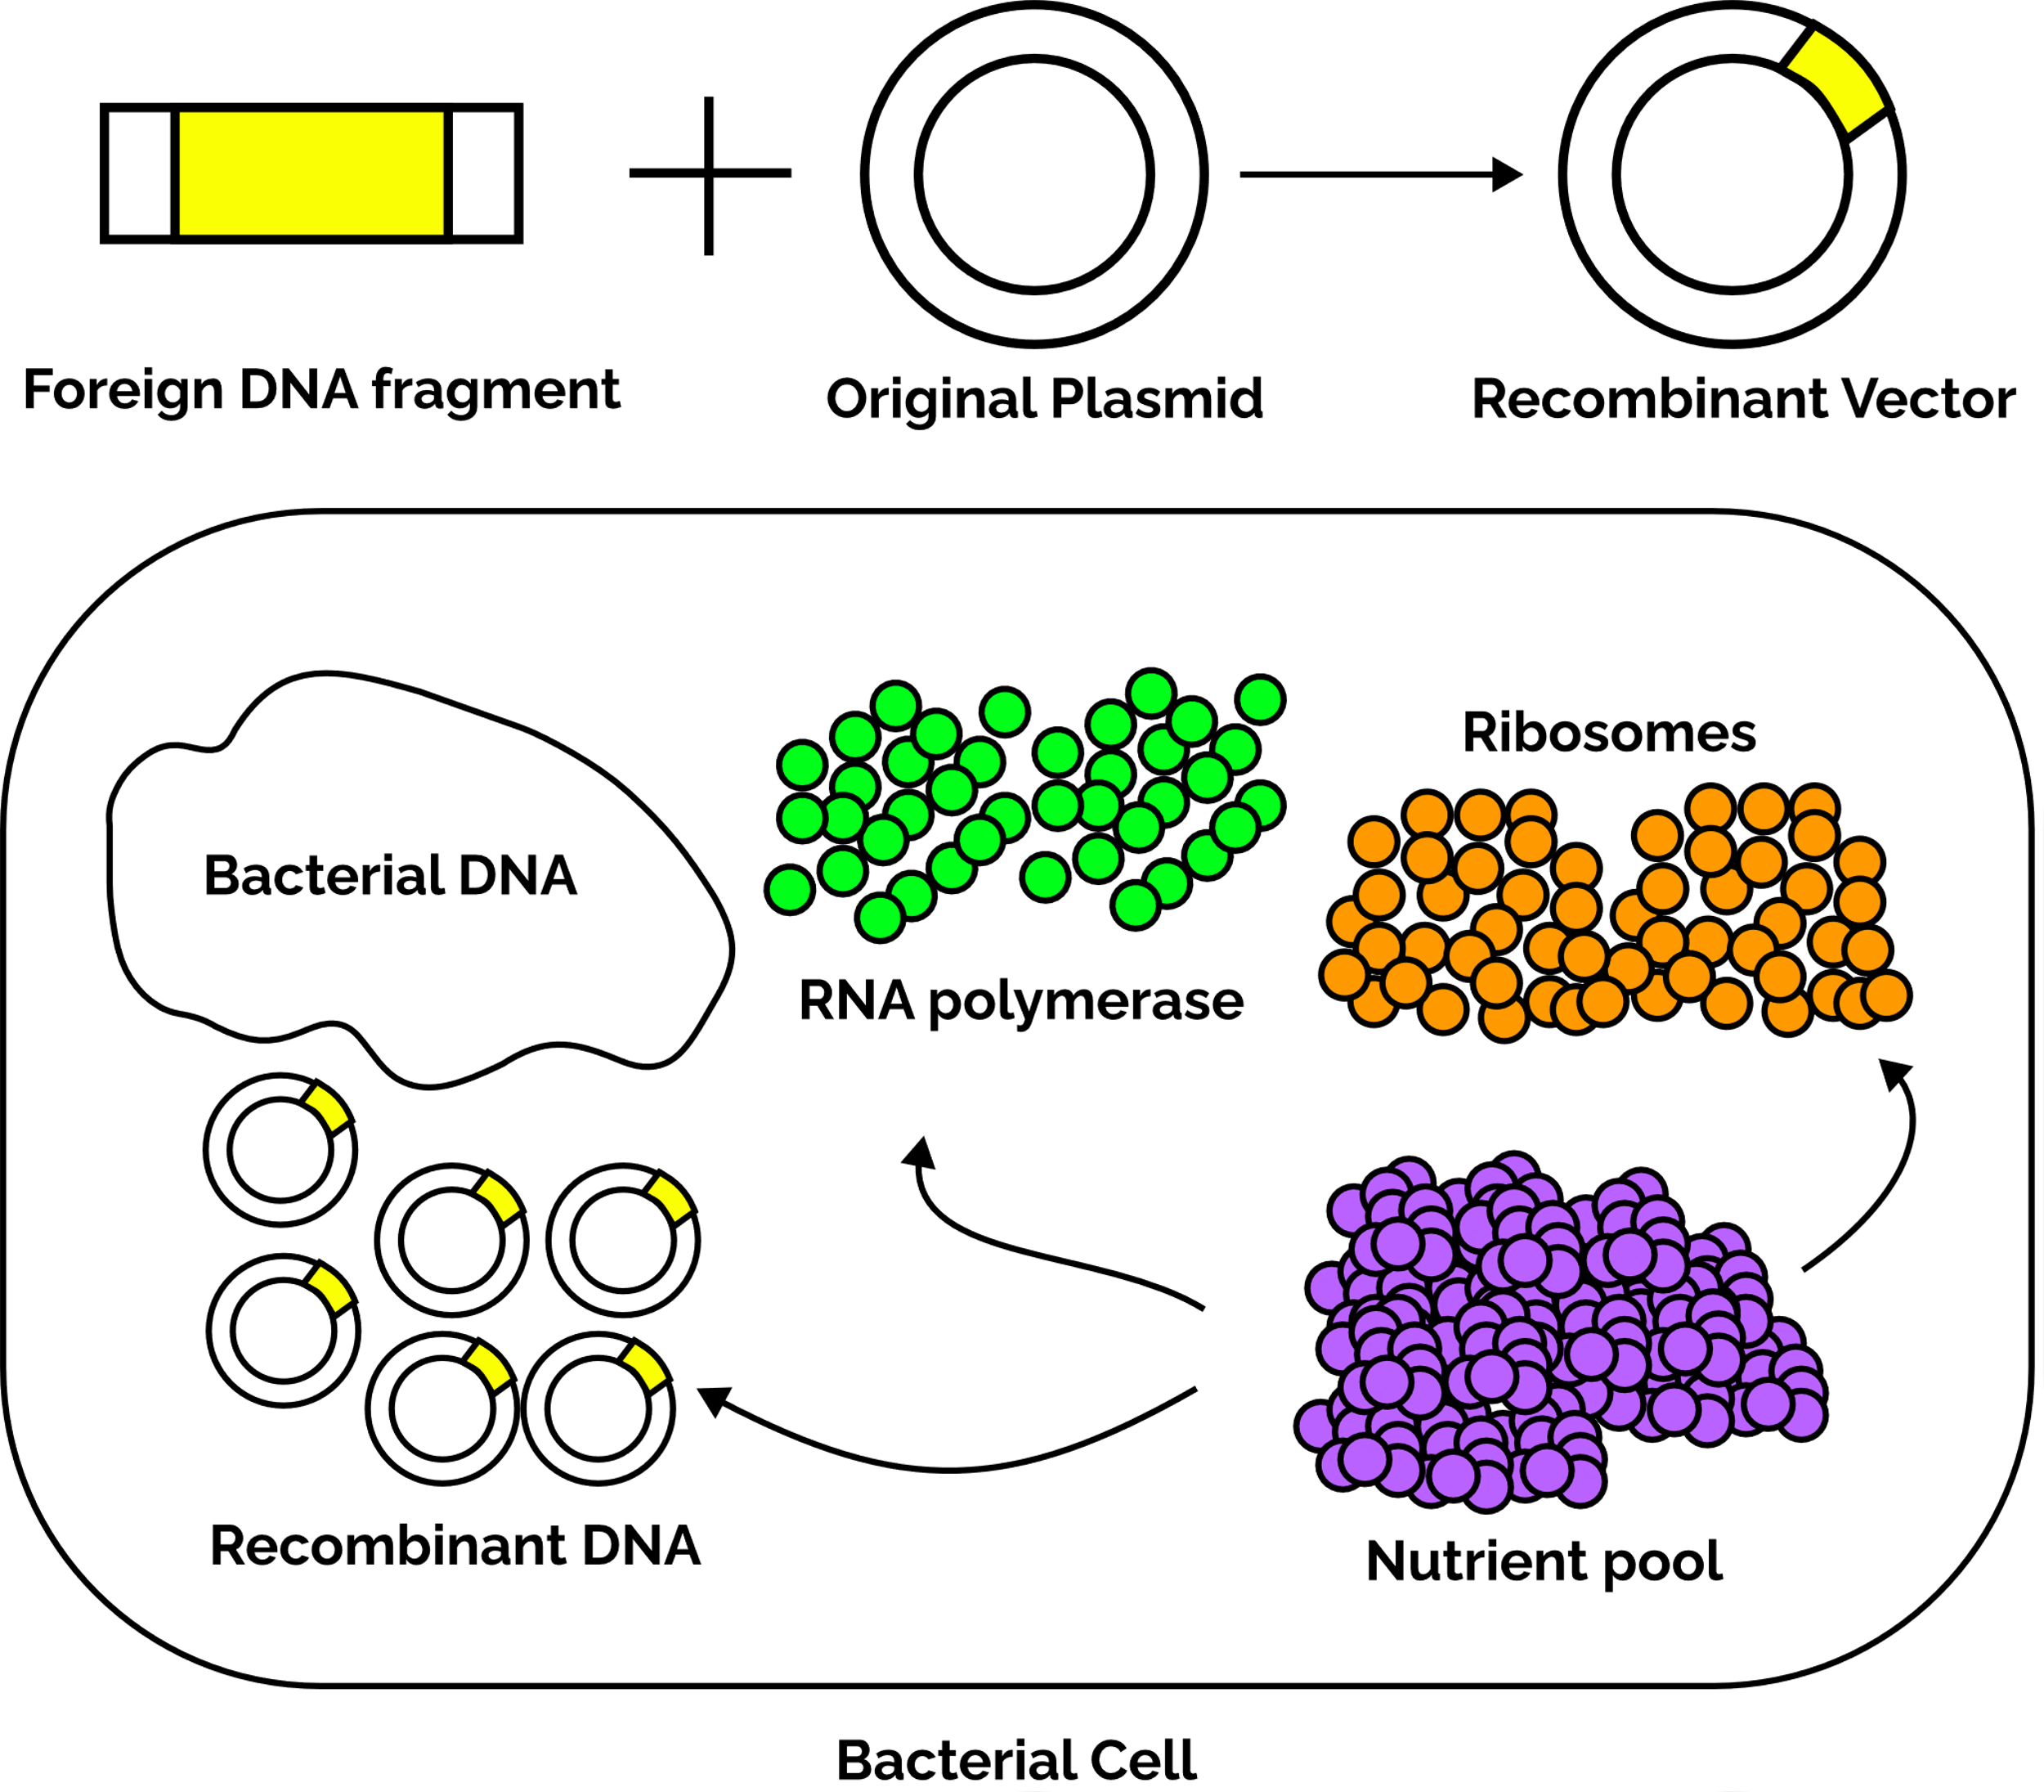
INTRODUCTION TO DNA RECOMBINATION
Genetic Engineering
Most proteins are difficult to manufacture with available synthetic capabilities
Genes that are involved in producing protein molecules can be assembled through gene manipulation to a cistron
The cistron encodes necessary information and utilize intrinsic gene expression machinery to produce target proteins

Slide 4
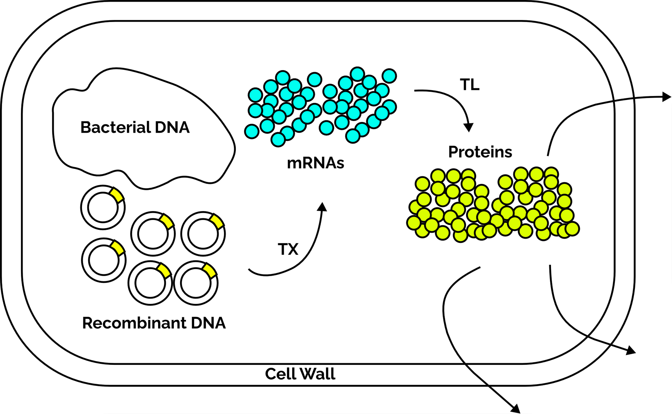
INTRODUCTION TO DNA RECOMBINATION
Gene expression

Slide 5
OBJECTIVES
General Objective
To develop a minimalistic mathematical model that grasps the basic mechanics of recombinant DNA expression
Specific Objectives
To understand the crucial checkpoints of protein expression
To understand the relationship between host history and protein production

Slide 6
MODEL DEVELOPMENT

Slide 7
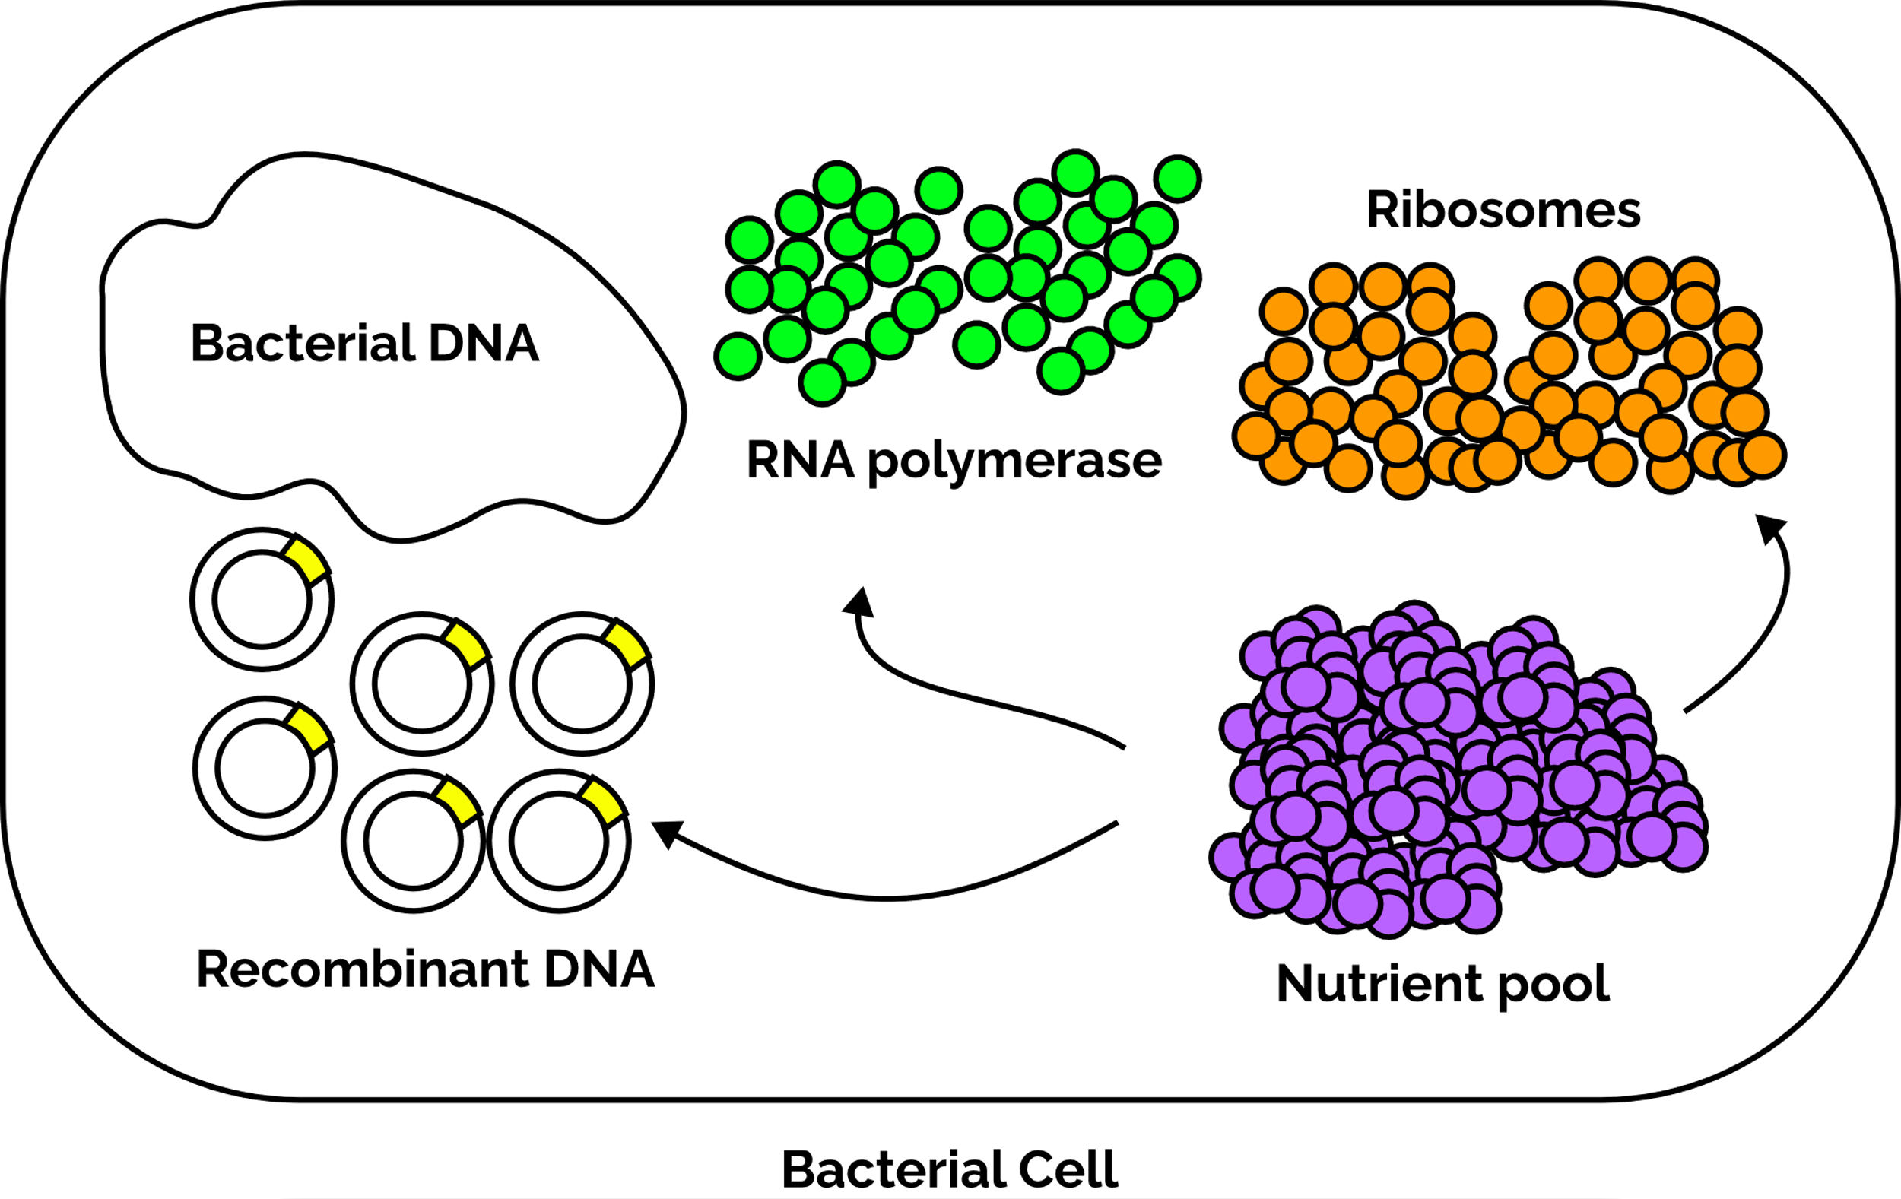
MODEL DEVELOPMENT
STEP 1
Assumptions
The bacterial cytoplasm is assumed to be homogenous and posses a fixed volume
The biochemical nutrient pool is large and the changes during consumption is negligible
No replication occurs within the simulation time/observation time
The resources available for expression is assumed to be in high numbers and continuum hypothesis and mass action-based formalisms become applicable
The synthesized proteins are assumed to be transported outside (i.e., to culture supernatant)

Slide 8
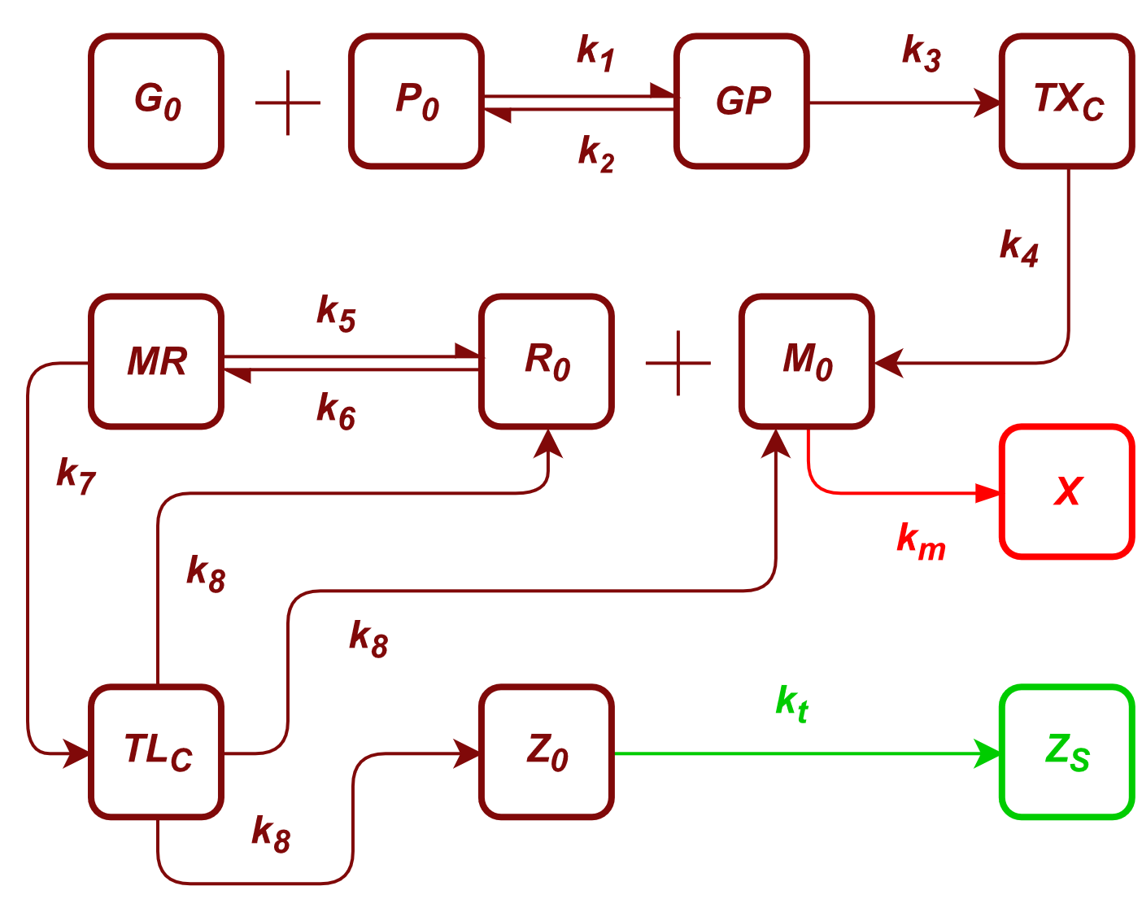
MODEL DEVELOPMENT
STEP 2
Understanding the biochemical interactions and developing a chemical reaction network
G₀ – plasmid
P₀ – RNA polymerase (RNAP)
GP – RNAP-plasmid complex
TX_{c} – escape committed complex
M₀ – mRNA
R₀ – ribosome
MR – mRNA-ribosome complex
TL_{c} – translation complex
Z₀ – reporter protein
Z_{s} – secreted protein
k1 – RNAP-promoter association
k2 – RNAP-promoter dissociation
k3 – transcription commitment
k4 – mRNA production
k5 – mRNA-ribosome association
k6 – mRNA-ribosome dissociation
k7 – translation commitment
k8 – protein production
k_{m} – mRNA degradation
k_{t} – protein transport

Slide 9
MODEL DEVELOPMENT
STEP 3
Develop differential equations for the formulated reaction network
Differential Equations
dG₀ = – k₁G₀P₀ + k₂GP + k₄TX_{C}
dP₀ = – k₁G₀P₀ + k₂GP + k₄TX_{C}
dGP = k₁G₀P₀ – k₂GP – k₃GP
dTX_{C} = k3GP – k4TX_{C}
dM₀ = k₄TX_{C} – k_{m}M₀ – k₅M₀R₀ + k₆MR + k₈TL_{C}
dR₀ = – k₅M₀R₀ + k₆MR + k₈TL_{C}
dMR = k₅M₀R₀ – k₆MR – k₇MR
dTL_{C} = k₇MR – k₈TL_{C}
dZ₀ = k₈TL_{C} – k_{t}Z₀
dZ_{S} = k_{t}Z₀

Slide 10
MODEL DEVELOPMENT
STEP 4
Carry out simulation for a collection of time points using a computational software (R and the package deSolve)
Initial Concentrations
G0 – 0.5 nM | TL_{C} – 0 nM
P0 – 0.5 nM | Z0 – 0 nM
GP – 0 nM | Zs – 0 nM
TX_{C} – 0 nM | M0 – 0 nM
R0 – 0.5 nM | MR – 0 nM
Rate Constants
k₁ – 6x10⁹ M⁻¹min⁻¹ | k₇ – 30 min⁻¹
k₂ – 6x10⁹ M⁻¹min⁻¹ | k₈ – 0.9 min⁻¹
k₃ – 60 min⁻¹ | k_{t} – 60 min⁻¹
k₄ – 0.9 min⁻¹ | k_{m} – 18 min⁻¹
k₅ – 6x10⁹ M⁻¹min⁻¹ | k₆ – 135 min⁻¹
Code Availability
https://github.com/zachariah-ibrahim/recombinant-DNA-expression
Parameter availability
Kierzek, A. M., Zaim, J., & Zielenkiewicz, P. (2001). The effect of transcription and translation initiation frequencies on the stochastic fluctuations in prokaryotic gene expression. The Journal of Biological Chemistry, 276(11), 8165–8172. doi:10.1074/jbc.M006264200

Slide 11
RESULTS & DISCUSSION

Slide 12
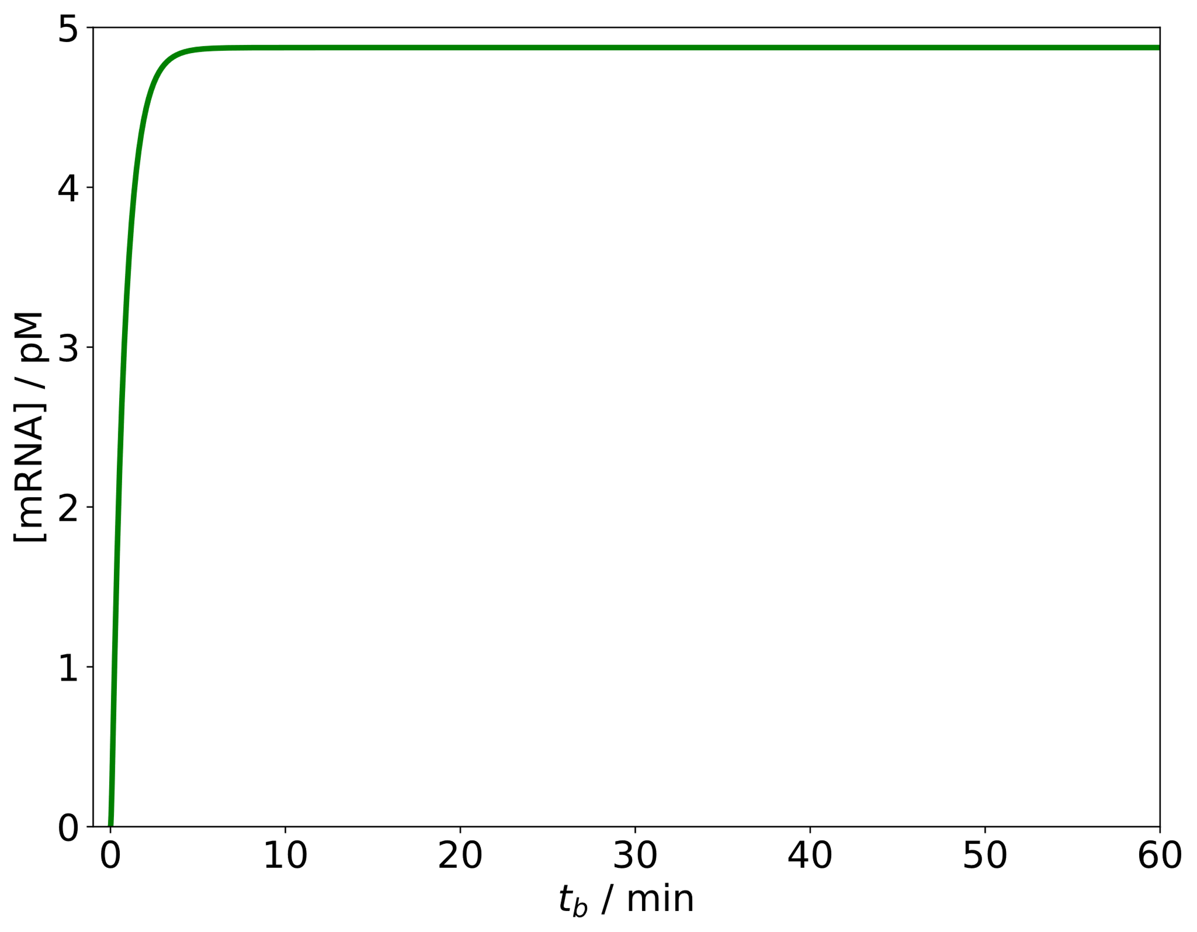
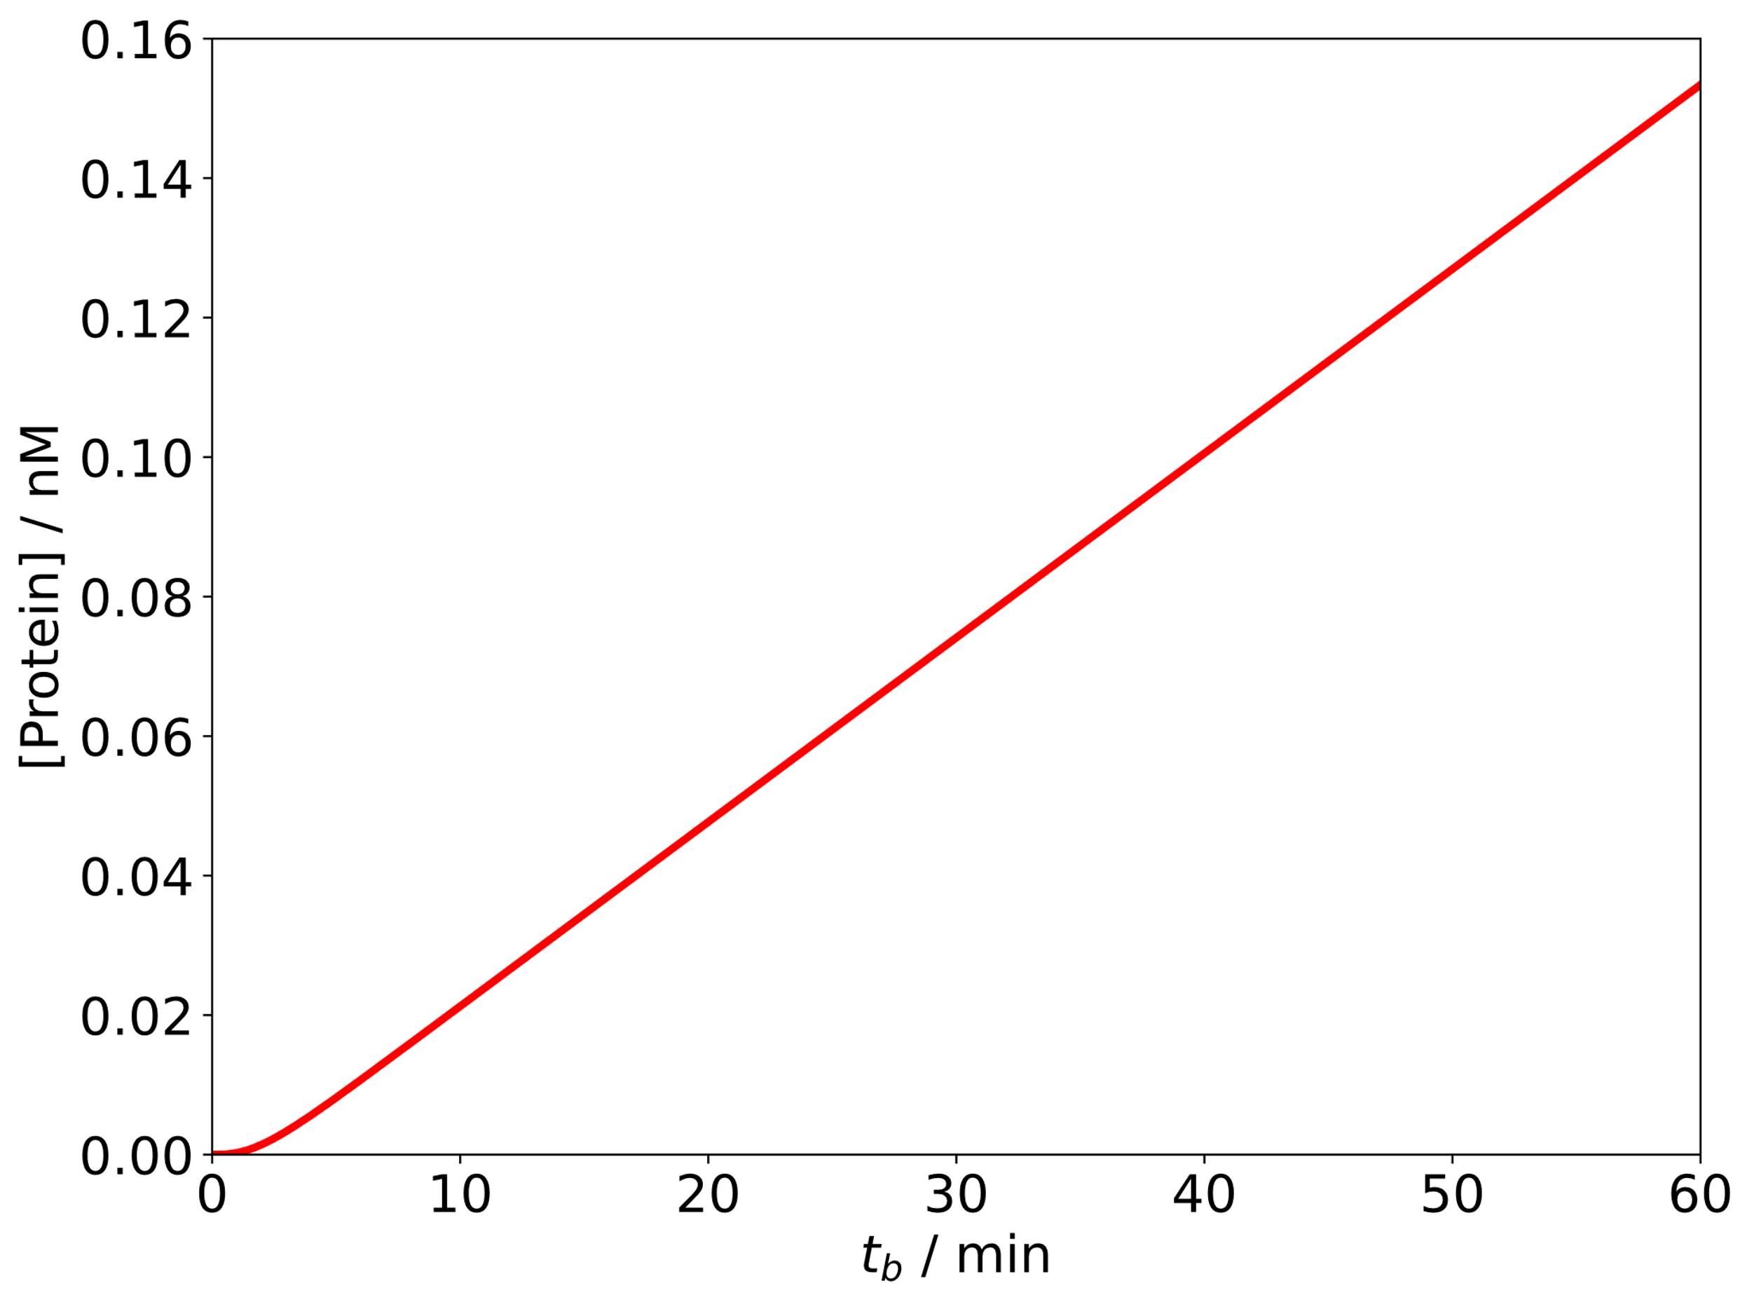
RESULTS & DISCUSSION
Simulation results (Default Settings)
mRNA within the bacterial cell shows saturation behavior
The protein production show a quasi-linear behavior

Slide 13
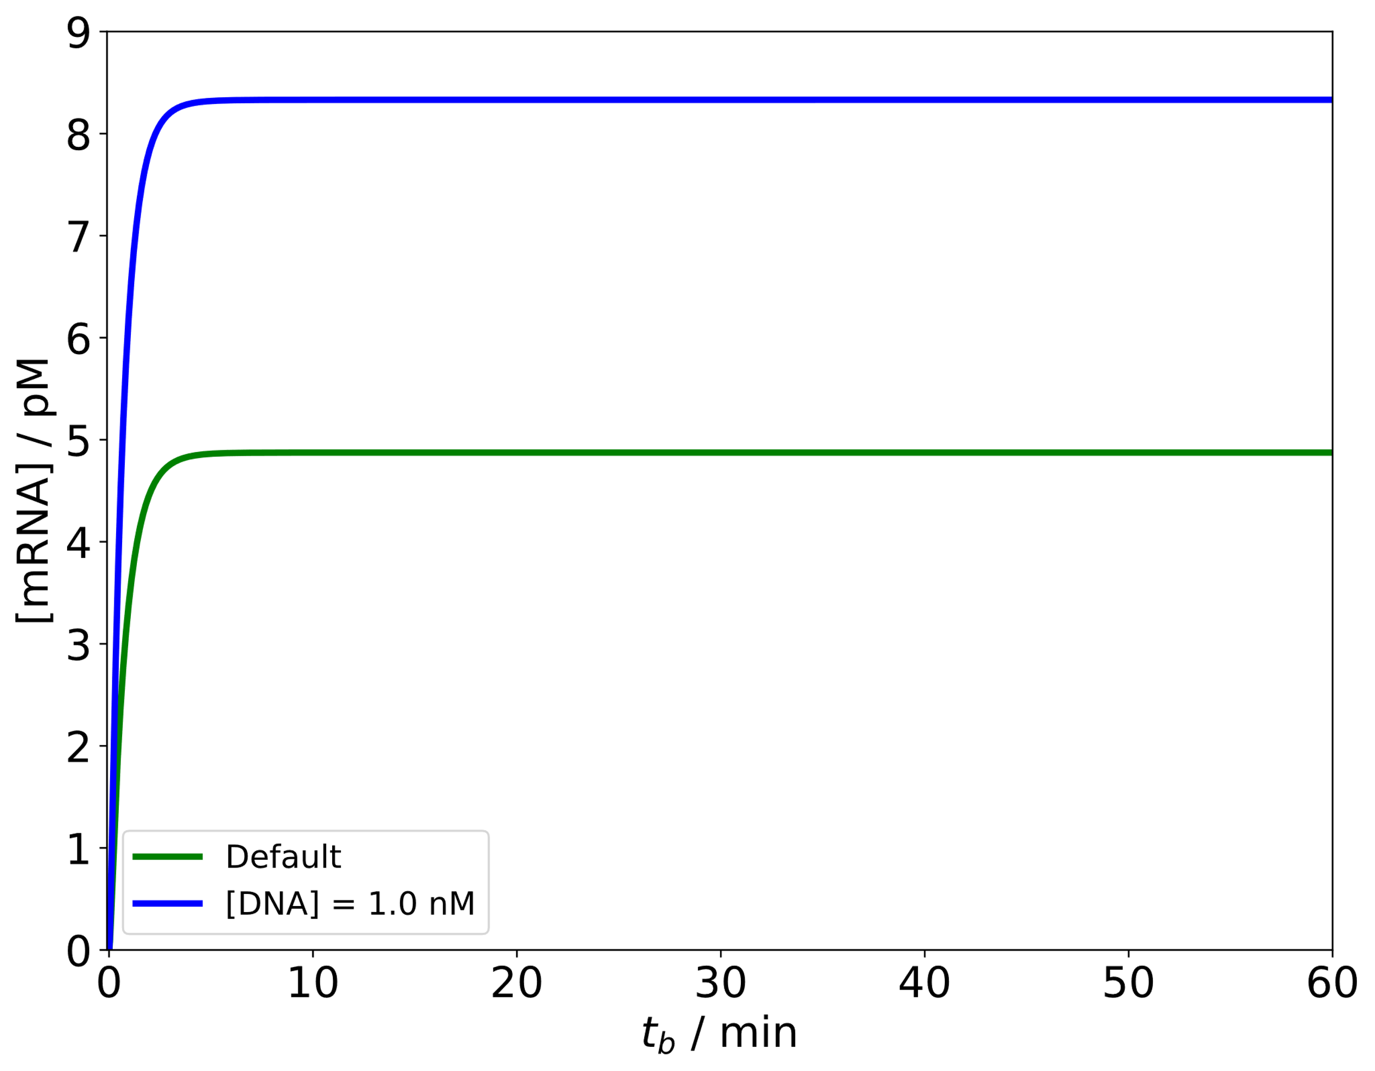
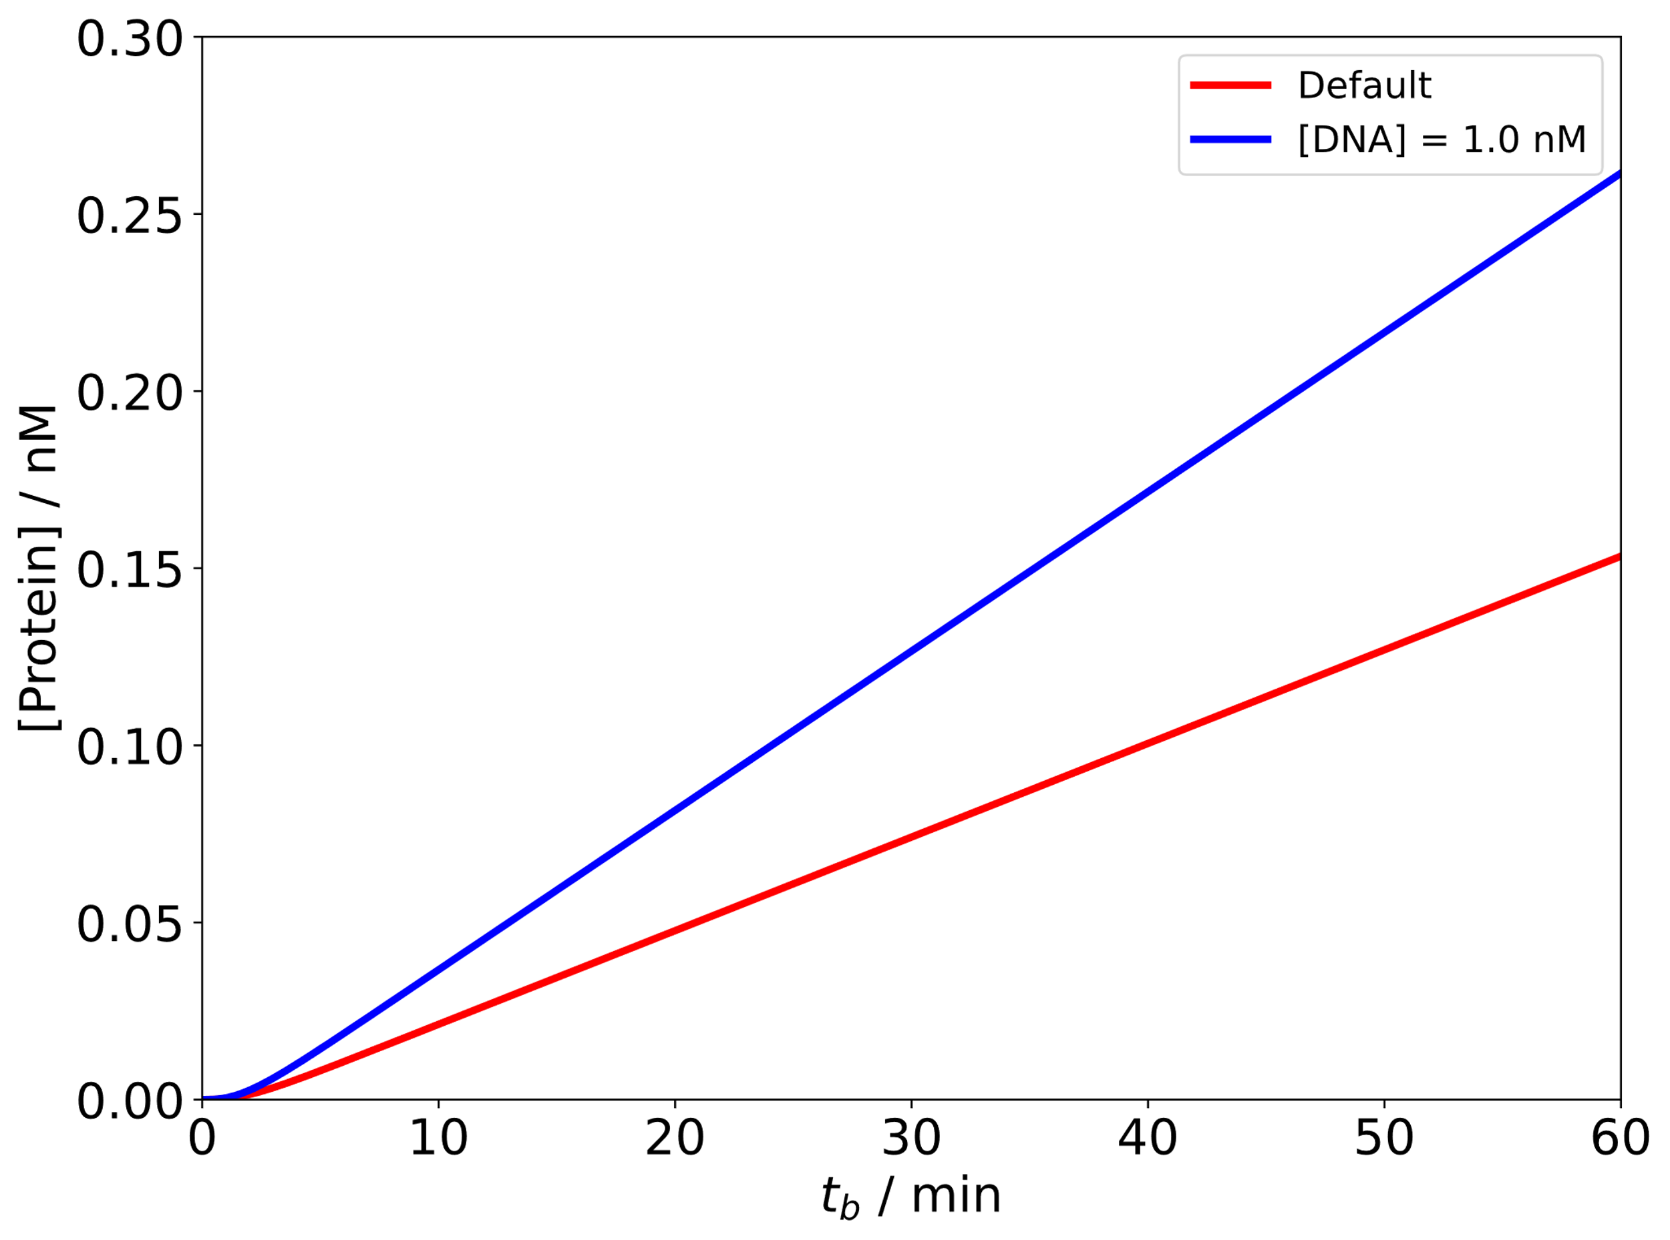
RESULTS & DISCUSSION
Simulation results (High copy number)

Slide 14
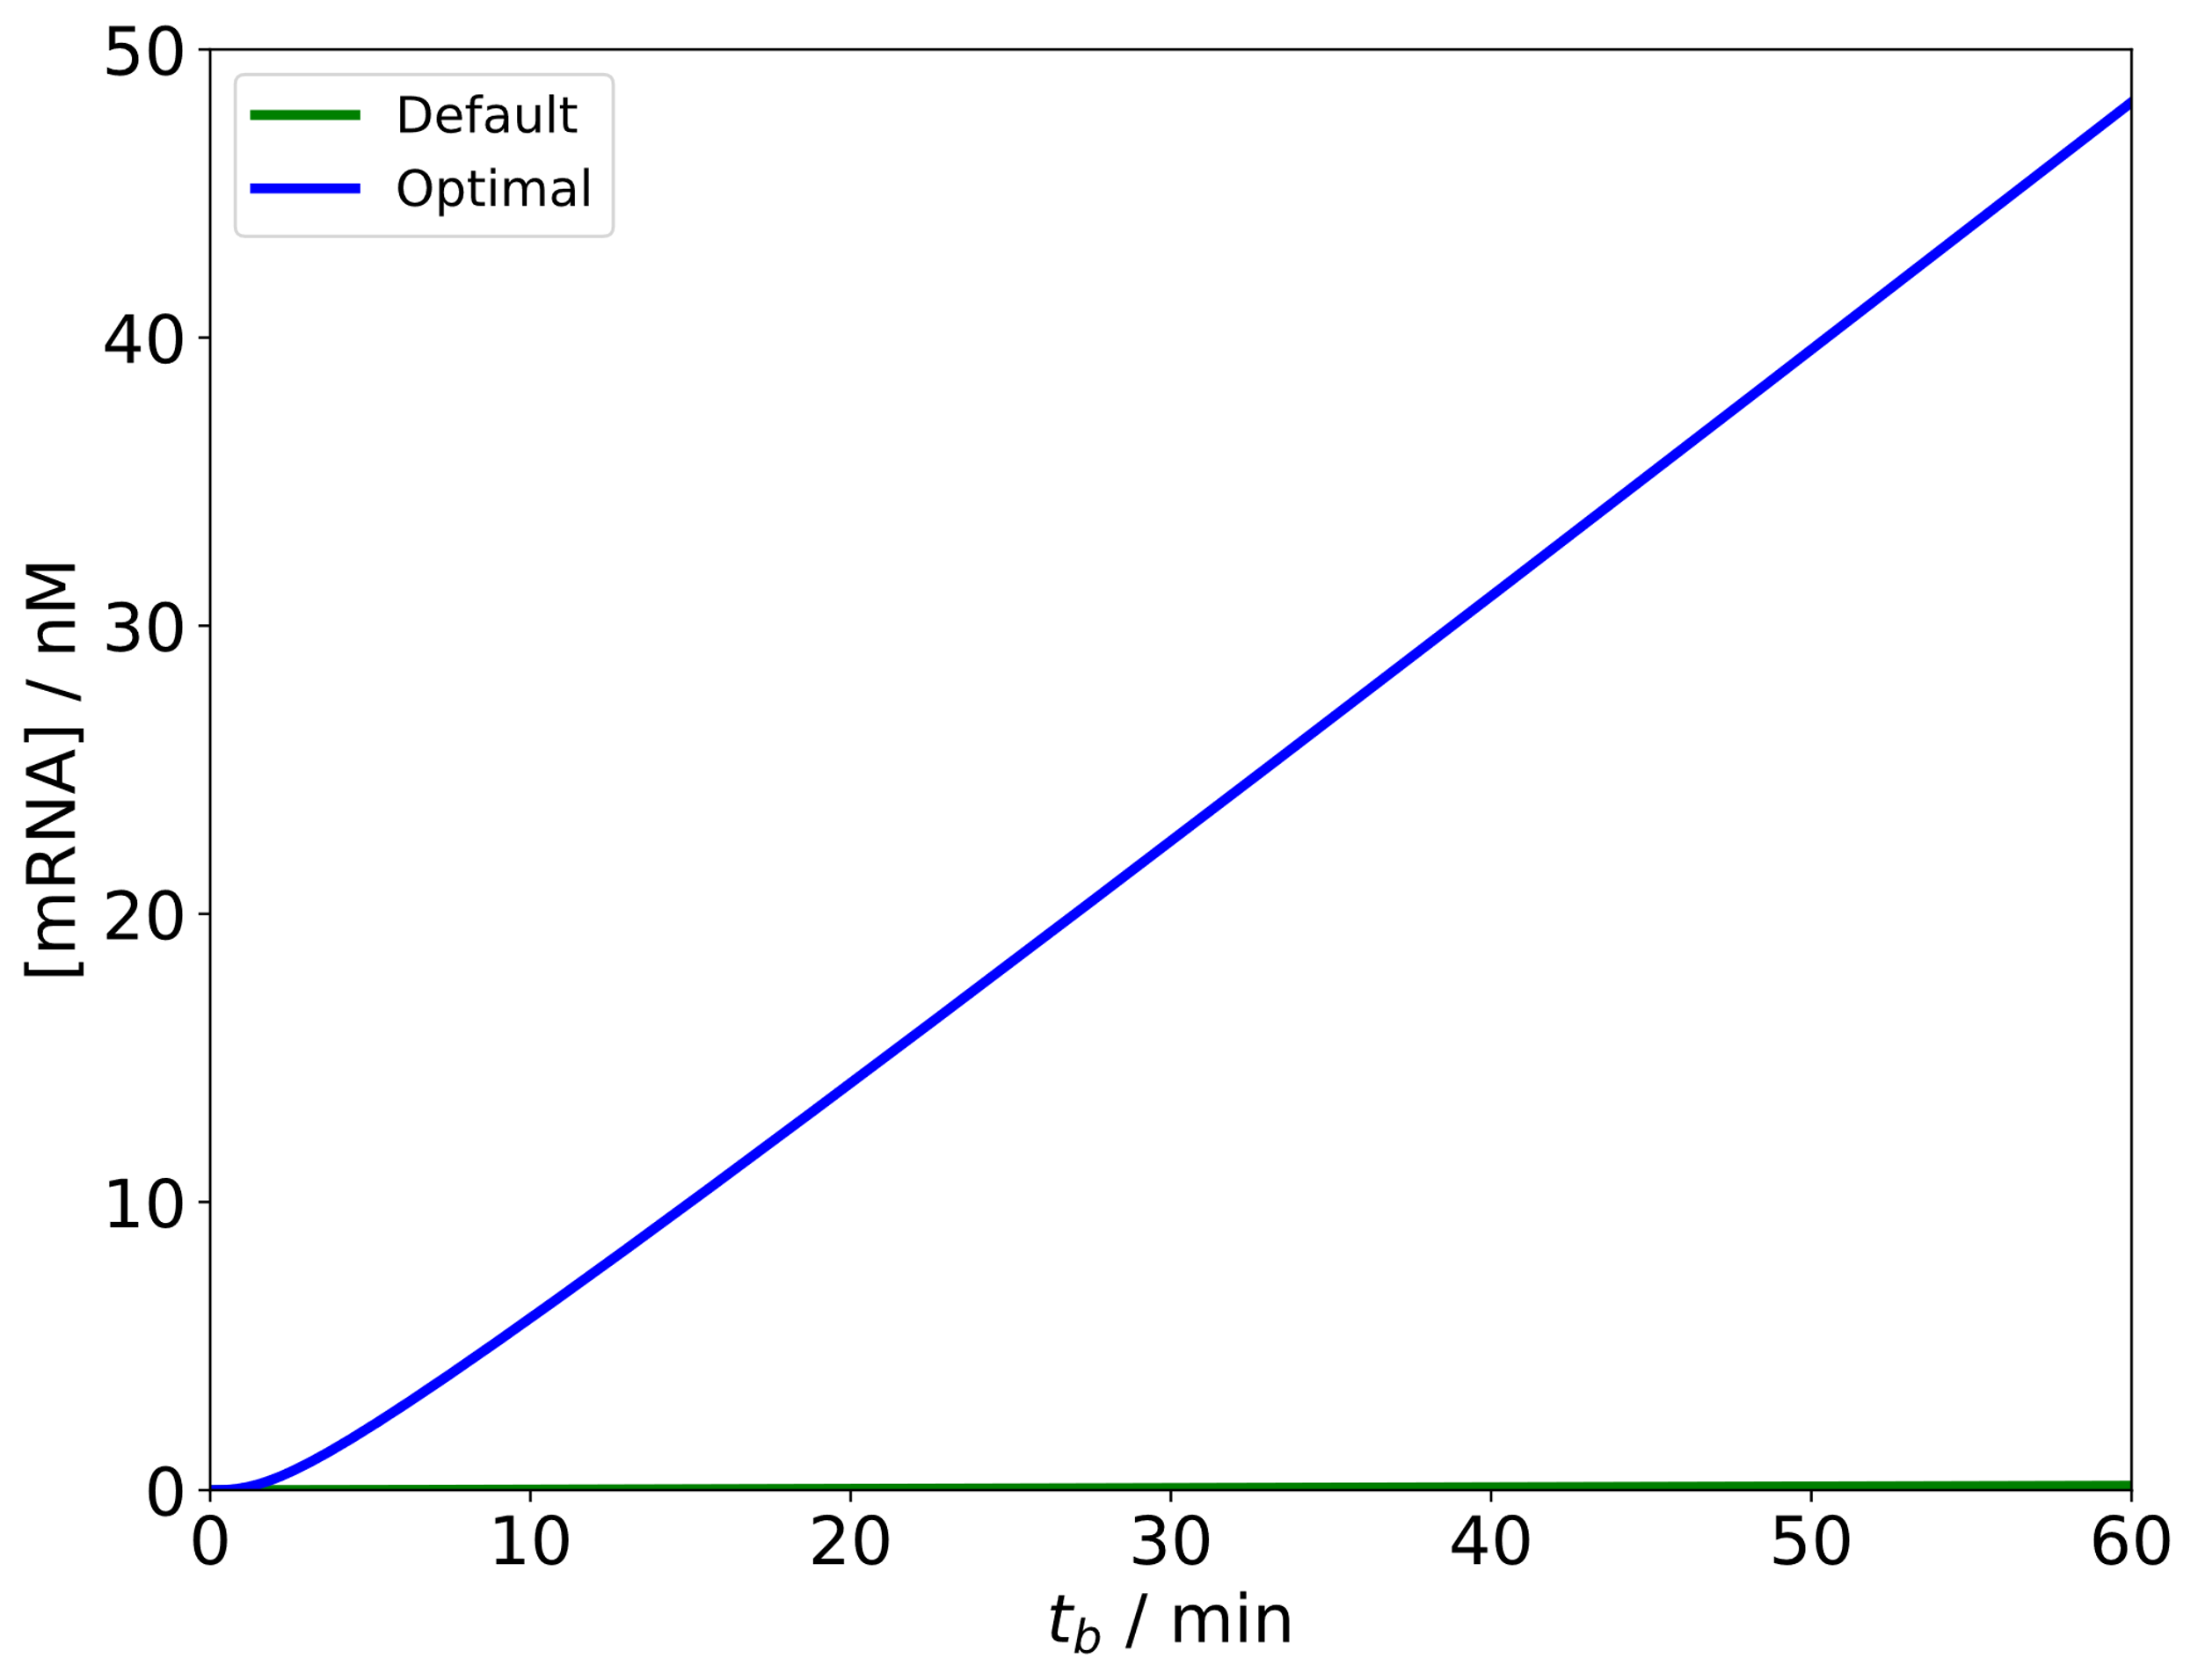
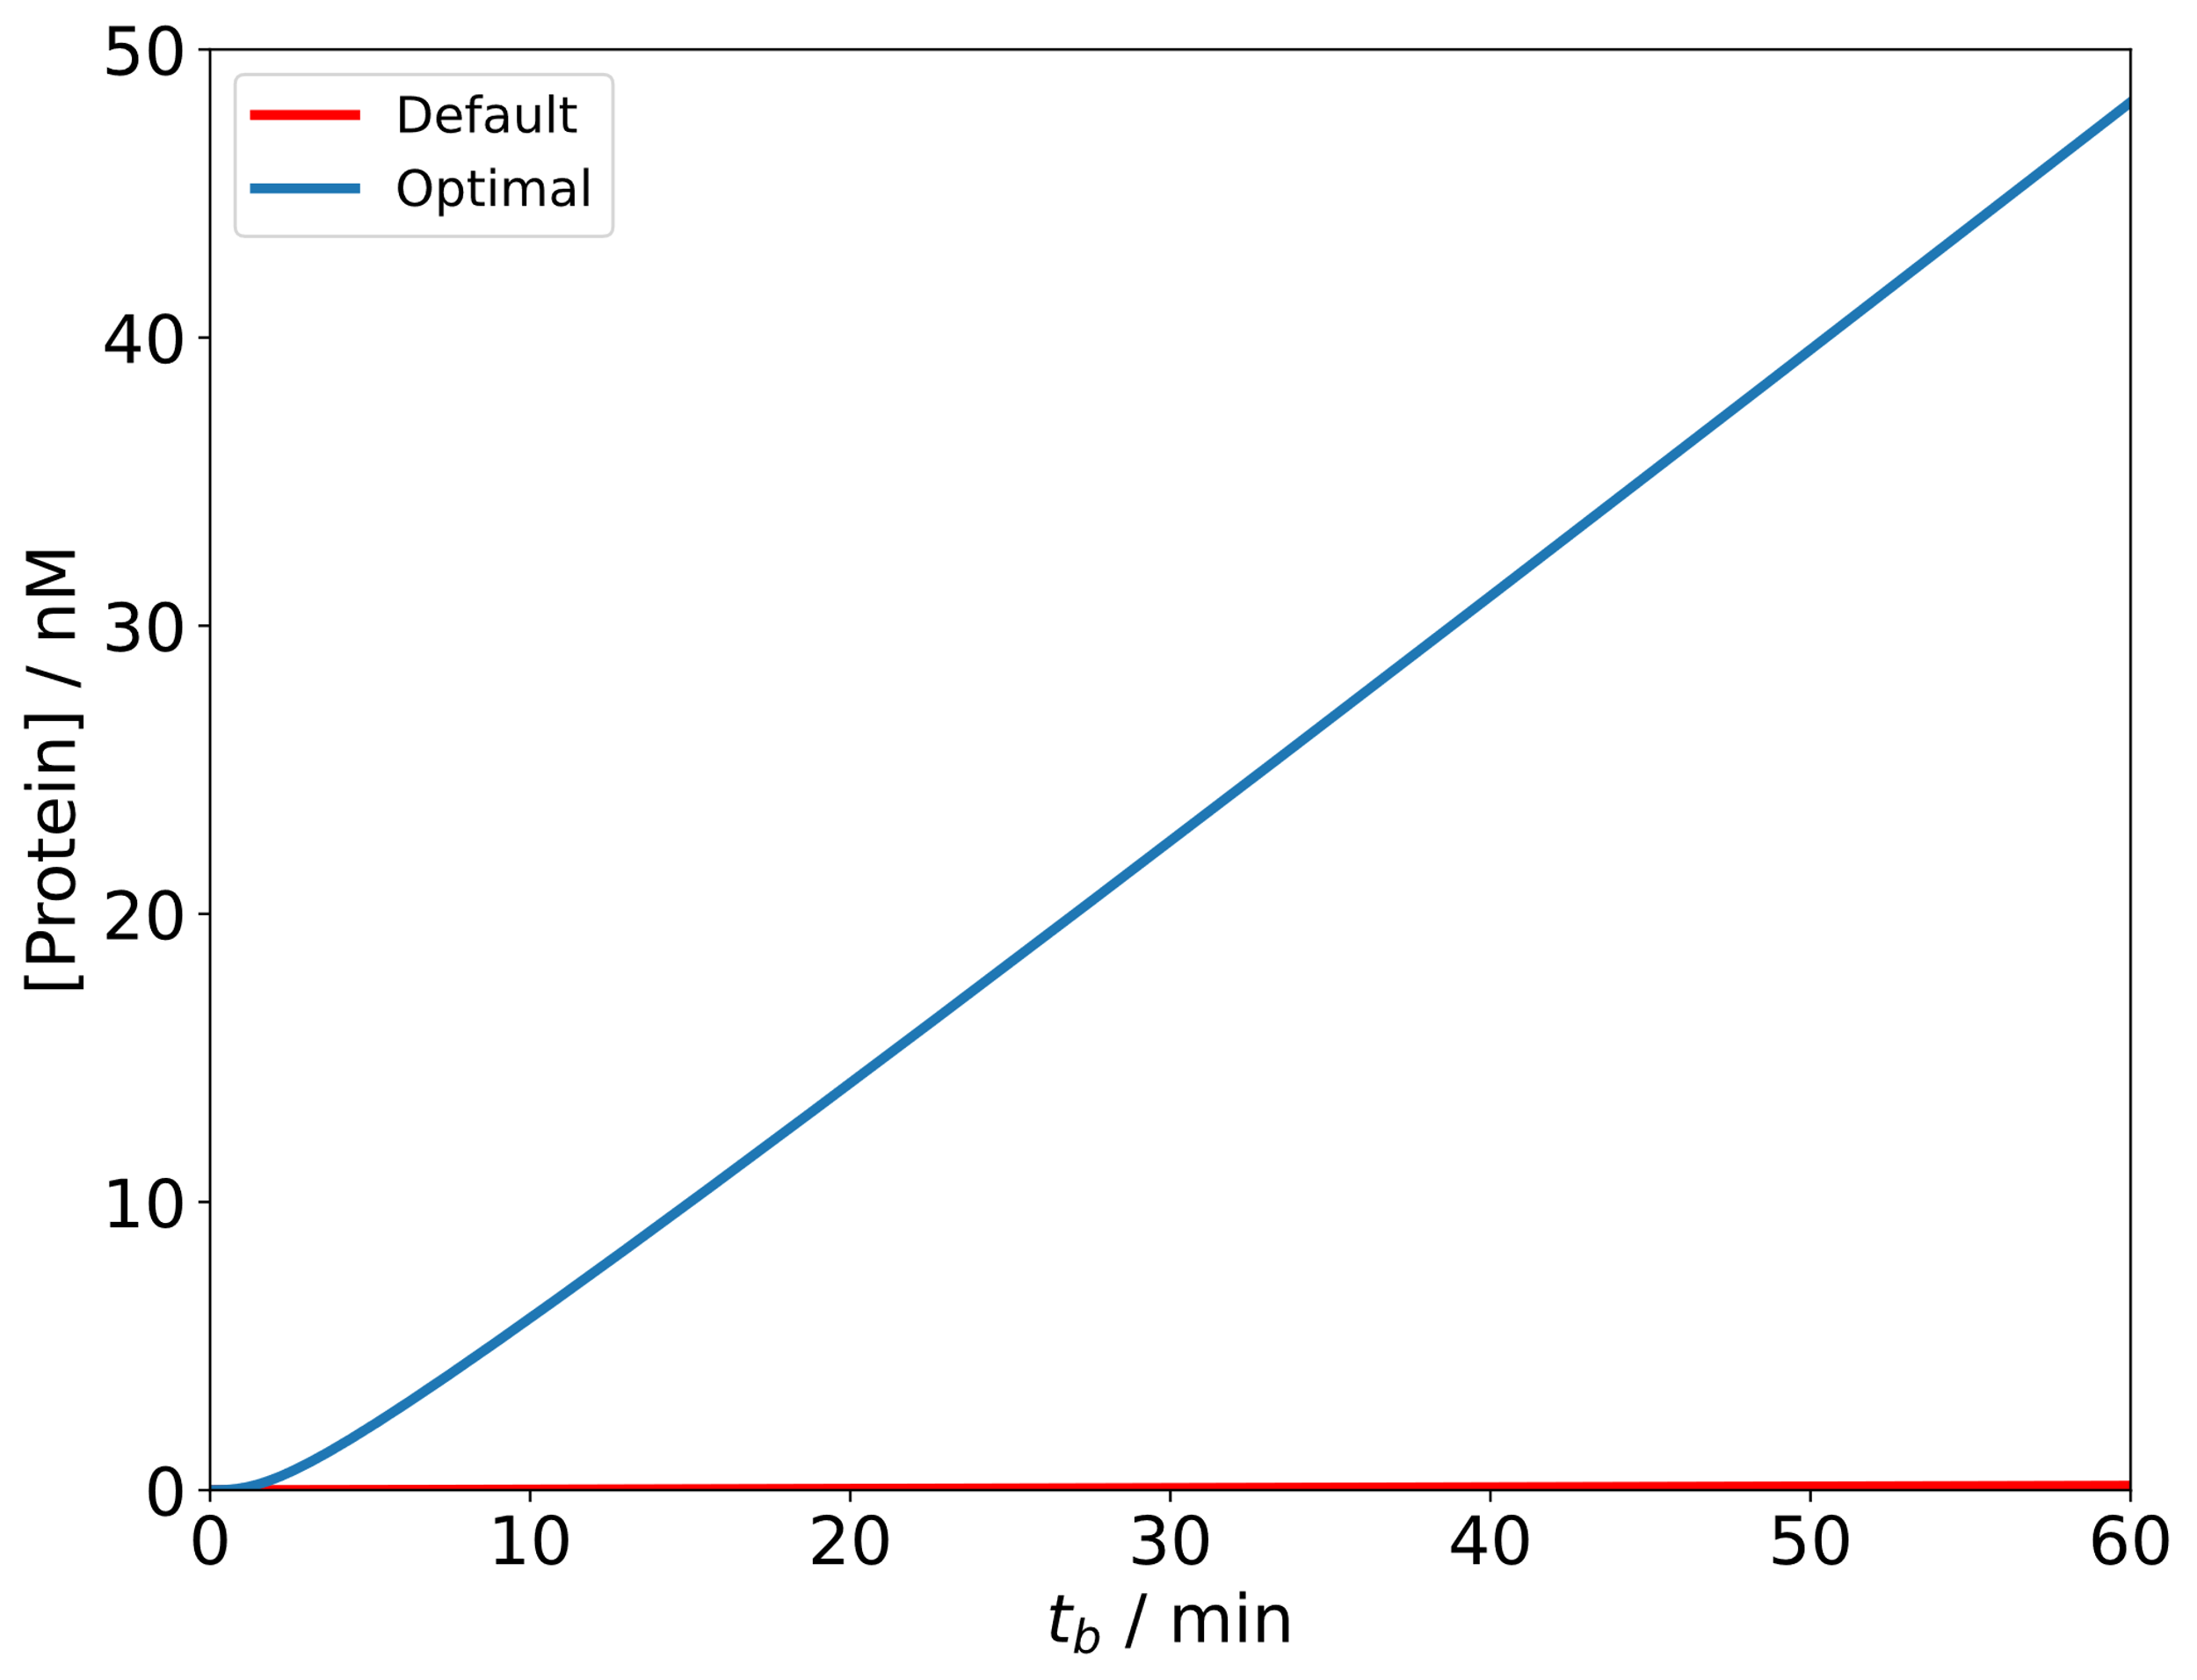
RESULTS & DISCUSSION
Simulation results (High copy number + no mRNA degradation + increased nutrient pool)

Slide 15
CONCLUSION
Positive modifications can improve the production yield significantly
Choosing a better candidate/host is also a promising approach to improve yield

Slide 16
THANK YOU

